Slide 1
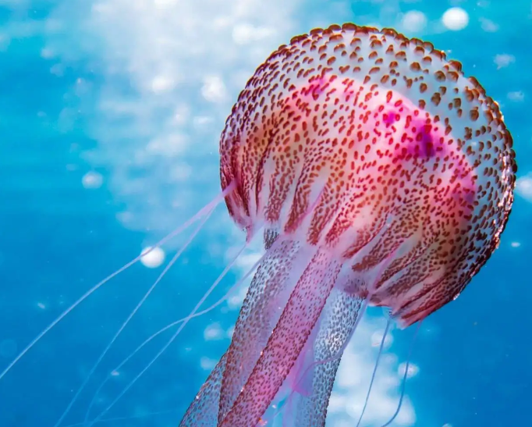
Vertebrates and Invertebrates – Page 1
Animals are broadly classified into two main groups: vertebrates and invertebrates. Vertebrates are animals that have a backbone or spinal column, which is part of an internal skeleton. This group includes mammals, like cats and humans, birds, fish, reptiles, and amphibians. Having a backbone helps these animals to move and support their body weight.
Into what two main groups are animals broadly classified? ___________________________________________________________________
What is a backbone or spinal column? ___________________________________________________________________
What are some examples of vertebrates? ___________________________________________________________________
Invertebrates, on the other hand, do not have a backbone. They form the largest group of animals on our planet. In fact, more than 90% of all animal species are invertebrates. These include creatures like insects, spiders, worms, jellyfish, and many more. Some invertebrates, like the octopus, are known for their intelligence and problem-solving abilities.
What are invertebrates? ___________________________________________________________________
What percentage of all animals are invertebrates? ___________________________________________________________________
What are four examples of invertebrates?
_____________________________________________________________
_____________________________________________________________
_____________________________________________________________
_____________________________________________________________

Slide 2
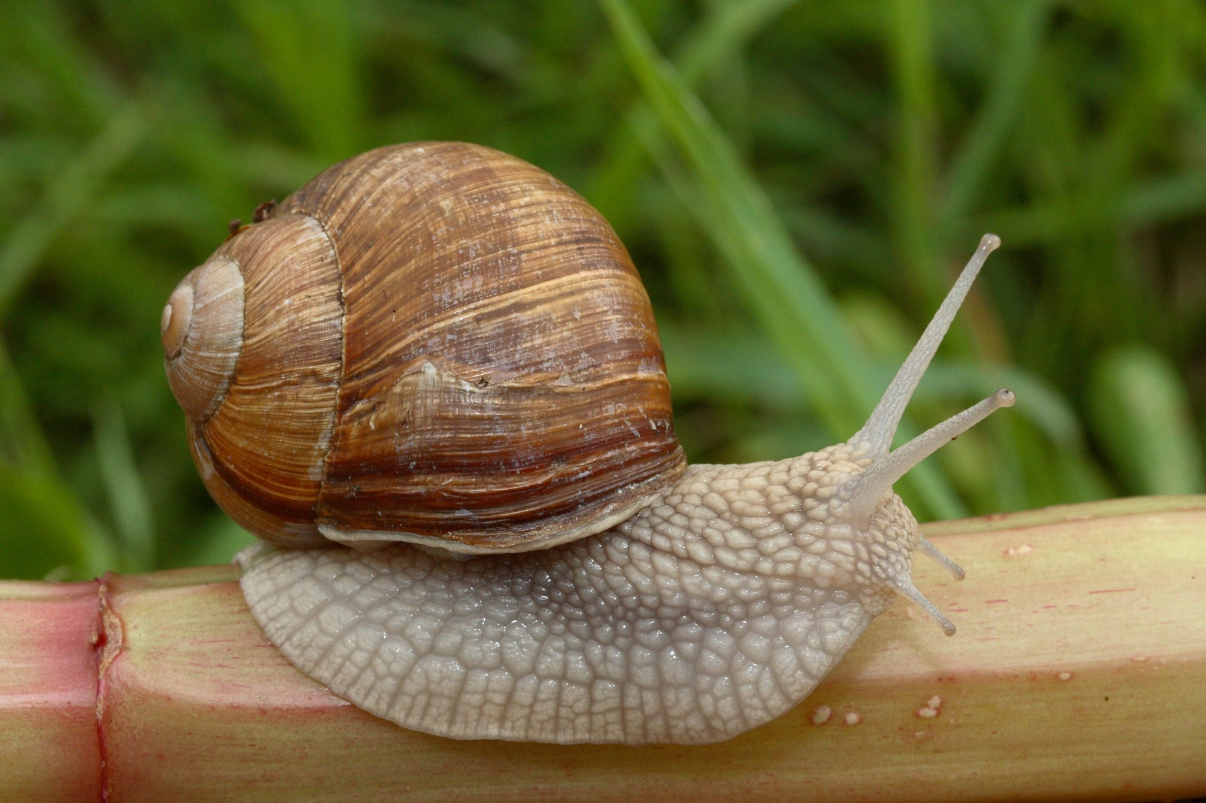
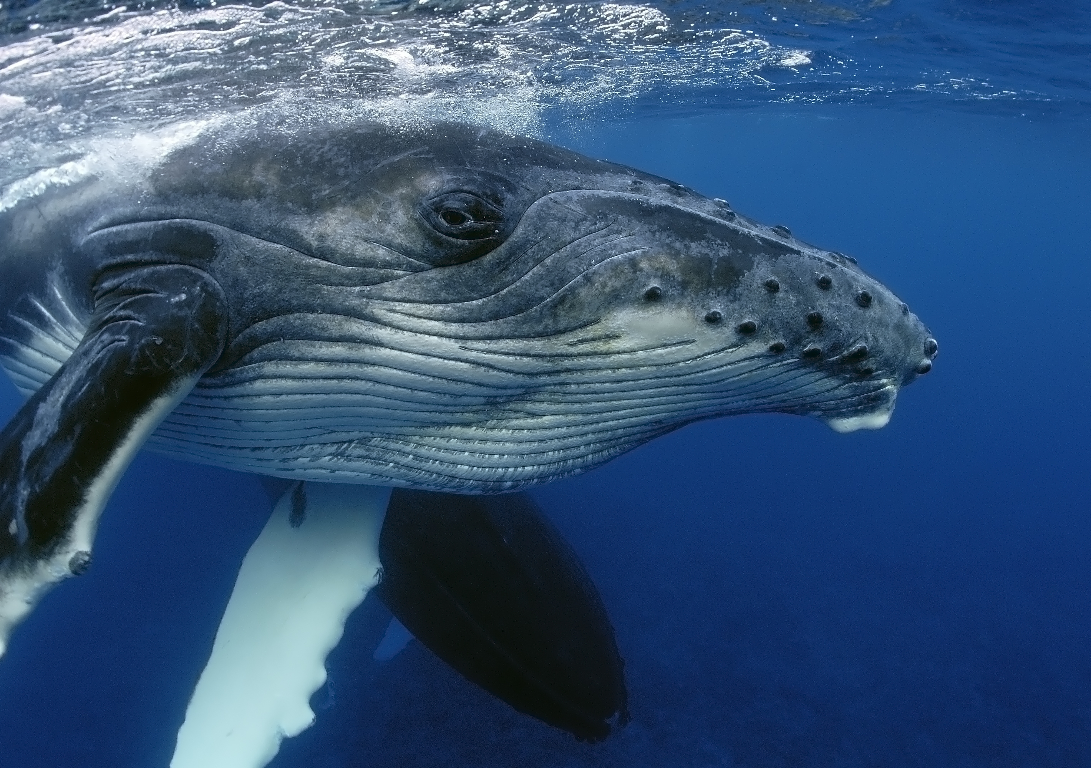
Vertebrates and Invertebrates – Page 2
Vertebrates and invertebrates have different body structures. Vertebrates have an internal skeleton that supports their body and allows movement. Invertebrates, however, may have a hard outer shell, like snails and crabs, or they may have a soft, flexible body, like worms and jellyfish. Despite these differences, all animals have their own unique ways to survive and thrive in their habitats.
How do vertebrates and invertebrates differ in terms of body structure? __________________________________________________________________
What features might an invertebrate have? __________________________________________________________________
Which invertebrates have a soft, flexible, body? __________________________________________________________________
There's an incredible amount of diversity within vertebrates and invertebrates. Each group includes animals of all sizes, from tiny insects to the largest whales, and they live in many different environments, from deep sea trenches to the highest mountains. It's truly fascinating to learn about all the unique creatures in our world and how they've adapted to their environments.
Can you give examples of the different sizes of animals in these groups? Large: ____________________________________________________________ Small: ____________________________________________________________
Where can these animals be found? __________________________________________________________________
Why is it fascinating to learn about these animals? __________________________________________________________________

